Slide 1


Slide 2


PROJECT EXHIBITION (DSN2099)
FINAL REVIEW
TEAM NO.100
PATIENT
DASHBORAD
Dr. Vikas Panthi (Guide )
Dr. Anand Motwani (Project Coordinator)

Slide 3
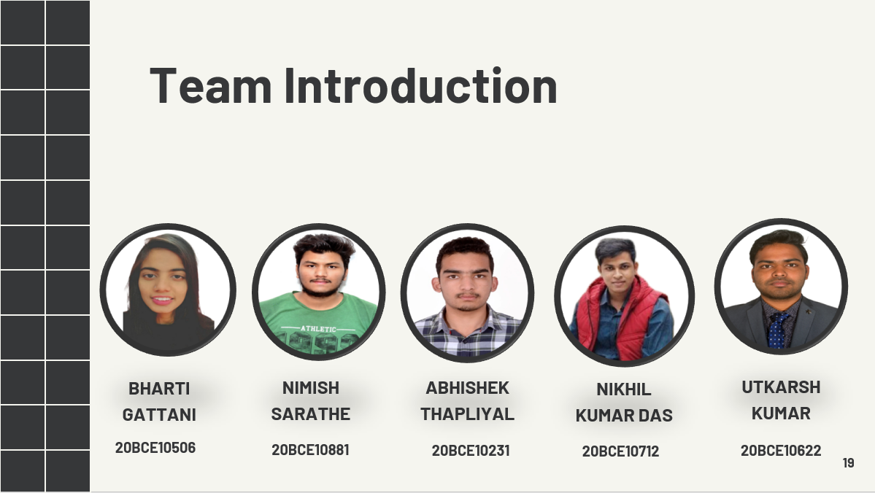
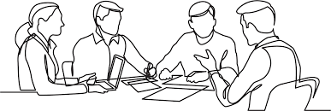

Slide 4


Slide 5

The Patient Dashboard is the first screen that displays when you access a patient’s record and is a great tool for creating a single location for displaying data you view on a regular basis.
If you are a first-time ClinicalConnect user, the Dashboard will be empty. You will need to populate the dashboard with clinical modules according to your clinical needs. Drag and drop the module icons found in the Patient Dashboard Header to add modules to your dashboard. The Patient Dashboard can also be accessed at any time by clicking the Dashboard: Patient option from the Clinical Modules menu.
INTRODUCTION
CONT…

Slide 6
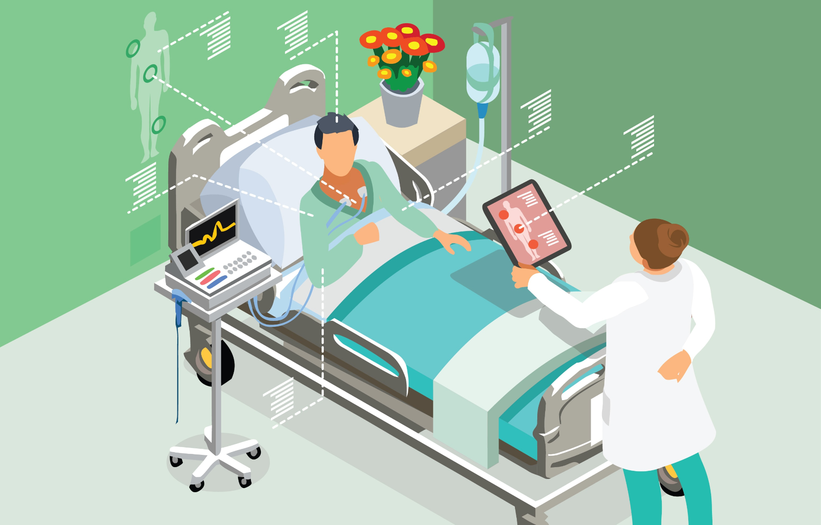
An interactive dashboard using Python(Streamlit, numpy , pandas) to easily collect and show all the details of a patient saved across various datasets in one place. This can help the patients and their caretakers to easily access the data regarding patient and take better care of them.

Slide 7

OBJECTIVE
The objective for the project is that many people in the world cannot easily access medical facilities majorly due to large distance from the hospitals.
This acts as a hinderance in their improvement and regular visiting of nurse is not a feasible solution.To resolve this issue we can use IoT enabled monitoring implants which can log the patient vital changes in the remote database server of the hospital.

Slide 8
PROBLEM STATEMENT
Keeping all the medical report at home is not an easy task and one needs to visit the hospital again and again to collect the report so this dashboard will make it easy for patient to access the report from anywhere and time on there device and save it without keeping the physical copies of the reports.

Slide 9
Hardware And Software Requirement
•Minimum CPU or processor speed-1GHz
•Minimum GPU or video Memory – 1GB
•Minimum system memory (RAM)-2 GB
•Minimum free storage space- 1GB
Audio hardware(sound card, speakers etc.)
Hardware
Software
VS code,
Heroku,
Pycharm,
Azure,
Docker File,
Numpy,
Pandas,
Streamlit.

Slide 10
Overall Architecture Diagram
Pandas: This is a library used for data manipulation and analysis. This library extracts and stores the data in your preferred format.
NumPy: It is a Python library used for working with arrays. It also has functions for working in domain of linear algebra, fourier transform, and matrices.
An API call is the process of a client application submitting a request to an API and that API retrieving the requested data from the external server or program and delivering it back to the client.

Slide 11
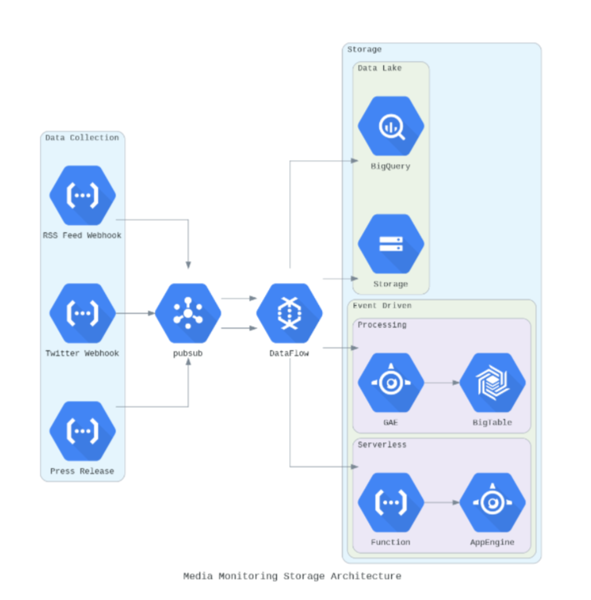
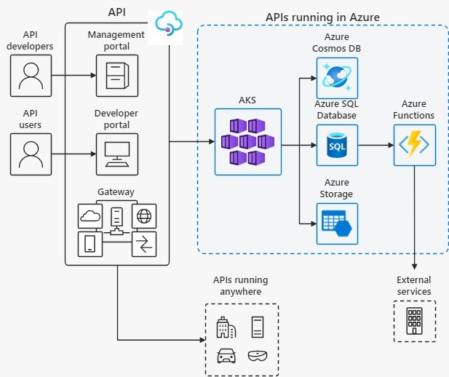

Slide 12
Module Split-up / Explanation
MySQL is an open source relational database management system. For WordPress sites, that means it helps you store all your blog posts, users, plugin information, etc. It stores that information in separate “tables” and connects it with “keys”, which is why it's relational.
Streamlit is an open-source python library for creating and sharing web apps for data science and machine learning projects. The library can help you create and deploy your data science solution in a few minutes with a few lines of code.
Pandas is a Python package providing fast, flexible, and expressive data structures designed to make working with “relational” or “labeled” data both easy and intuitive. It aims to be the fundamental high-level building block for doing practical, real-world data analysis in Python. Pandas is mainly used for data analysis and associated manipulation of tabular data in Dataframes.
NumPy can be used to perform a wide variety of mathematical operations on arrays. It adds powerful data structures to Python that guarantee efficient calculations with arrays and matrices and it supplies an enormous library of high-level mathematical functions that operate on these arrays and matrices.

Slide 13
WEBSITE DEMO

Slide 14
PATIENT DASHBOARD
WEBSITE LINK:-
https://patient-dashboard-streamlit.herokuapp.com/
SOME PATIENT ID’S:-
76982e06-f8b8-4509-9ca3-65a99c8650fe ad2e9916-4979-40fc-a8c0-68651a0cb5a6 518f83f3-a717-4705-a181-06e205df480b

Slide 15
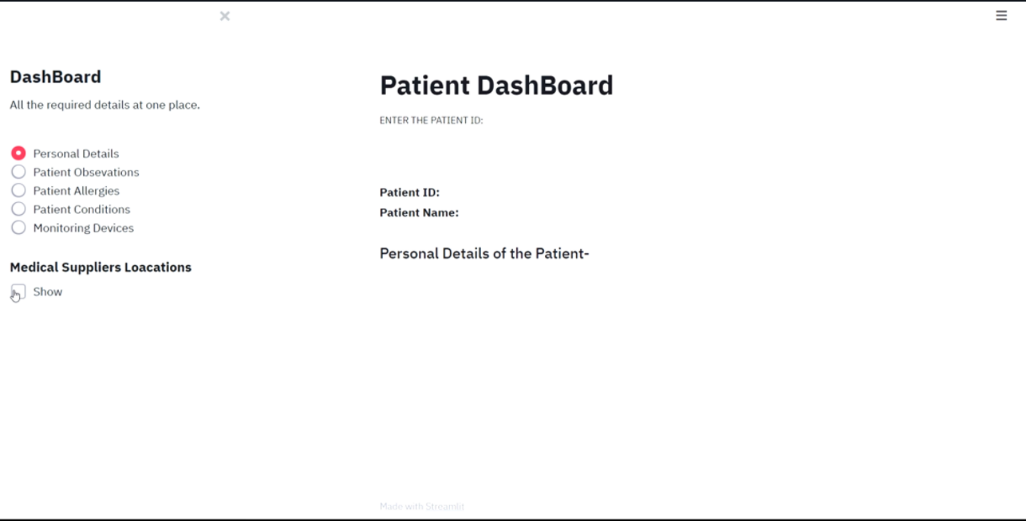

Slide 16
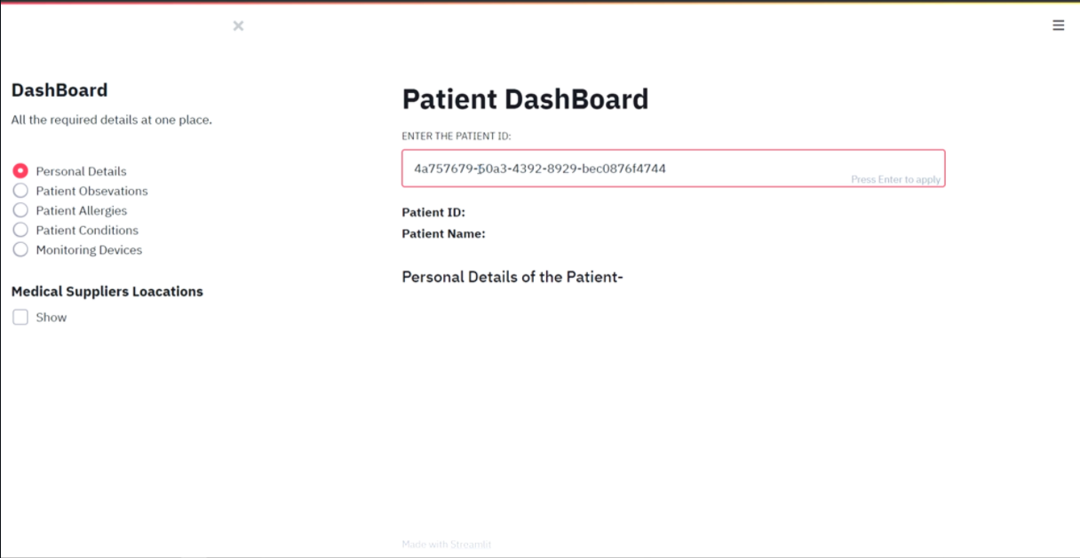

Slide 17
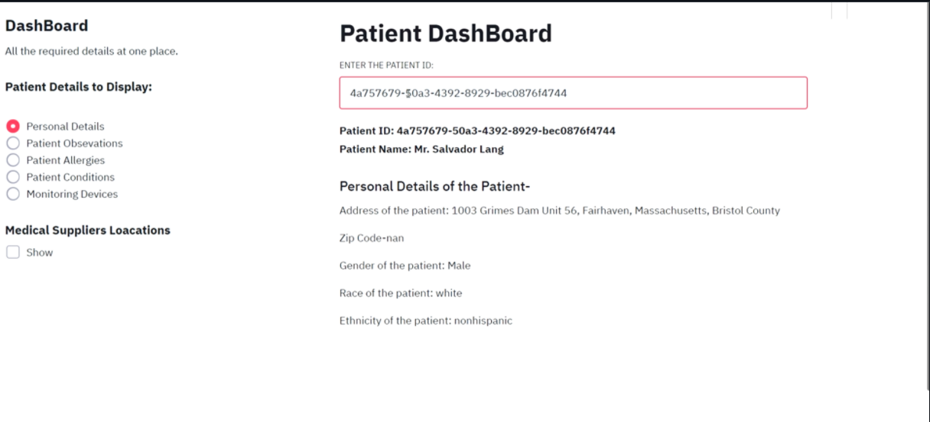

Slide 18
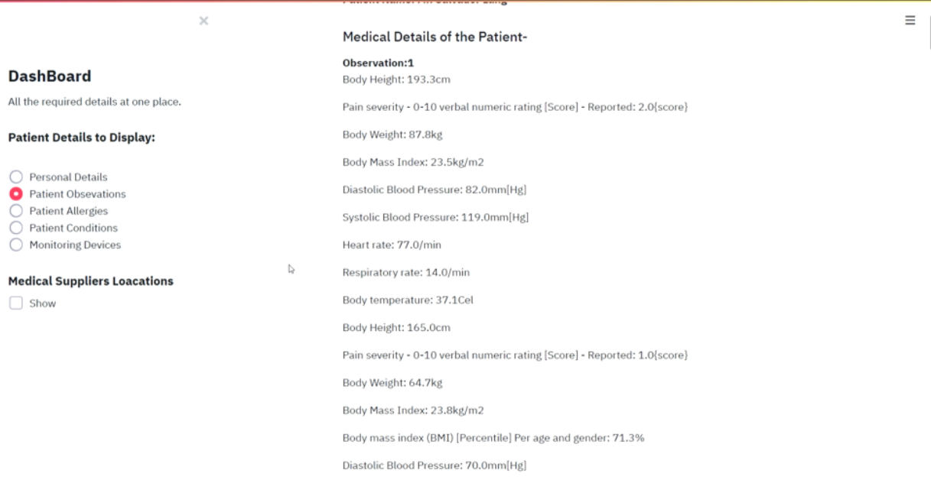

Slide 19
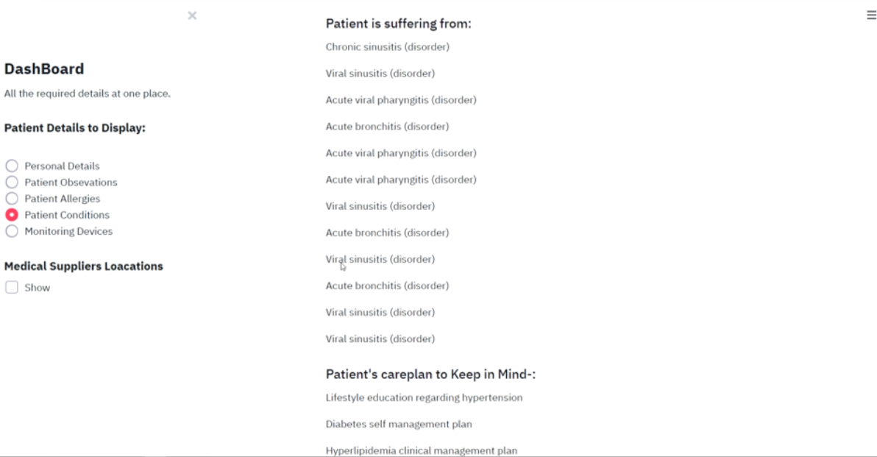

Slide 20
Conclusion
This patient dashboard can be a very useful tool for patients . It will save a lot of time and space of patients as it can be accessed anytime from anywhere in the world. We are still working on this project and trying to add more and more features to this dashboard.

Slide 21

References
https://www.udemy.com/course/the-complete-guide-to-angular-2/
https://medium.com/dsc-vit-bhopal/how-the-internet-works-http-concept-a5c08b4234b2
https://getbootstrap.com/docs/5.1/getting-
https://medium.com/dsc-vit-bhopal/how-the-internet-works-http-concept-a5c08b4234b2
https://www.geeksforgeeks.org/web-development
https://rapidapi.com/hub
https://www.boldbi.com/dashboard-examples/healthcare/patient-monitoring-dashboard

Slide 22
Individual Contribution
BHARTI GATTANI Data collected from KAGGLE
NIMISH SARATHE
UTKARSH KUMAR We put the collected data in SQL server from CSV file
NIKHIL KUMAR DAS Fetching the data from SQL using NODE JS, UI implementation.
ABHISHEK THAPLIYAL Importing the data from SQL using PANDAS.

Slide 23


